Slide 1
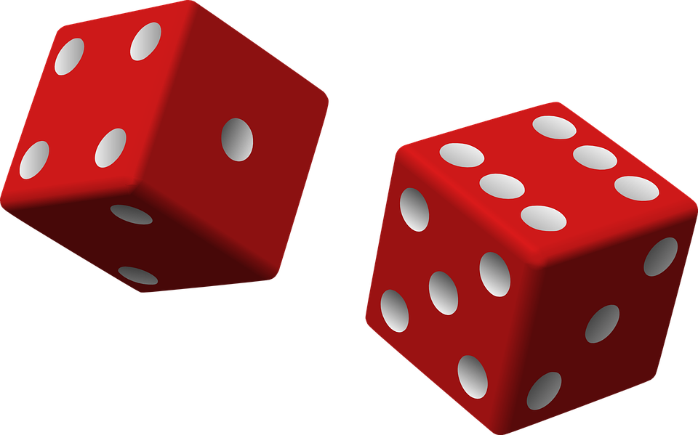

Mobile Gaming
Summer Camp
1:00 pm - 4:00 pm
6/19 - 6/22

Slide 2
Introductions

Slide 3
Introduce yourself
Share 2 truths and a lie about yourself
Instructors

Slide 4
Objectives
Collaborate with your classmates to design awesome games!
We’ll learn the Design Thinking process
A user-centered approach to design games
Along the way, we’ll learn computer science!

Slide 5
What is your favorite game?
What things make that game fun?

Slide 6
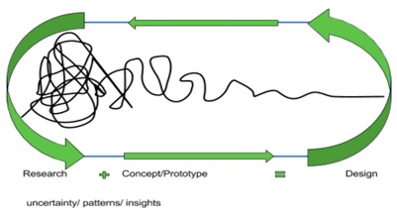
Empathy/Define
Prototype/Test
The Game
Empathy: Be able to step in another person’s shoes, and see what they see
Define: Ask questions: What are the user’s needs/wants? Issues? Likes/Dislikes?
Brainstorm more than one solution to the user’s issues
Prototype: Design a game based on user feedback
Test: Have your classmates test out your game and give you feedback
REPEAT!!!

Slide 7
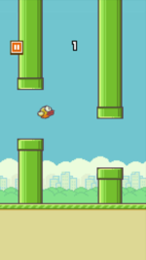
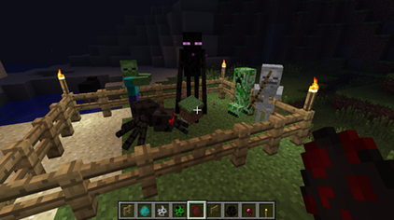
Design Thinking I
Empathy/Define
What is your favorite game to play?
Why is this your favorite game?
What makes this game fun?

Slide 8
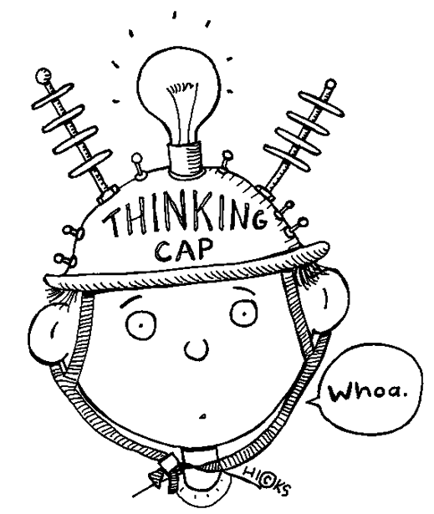
Keep those design thinking questions/answers in mind for when you start to create your games!

Slide 9

Game Design
Game Building
Hyperpad (Gamepress)
Advanced level design
Advanced characters
Advanced game play and logic
Design Thinking
User-centered approach to solve problems and design
Computer Science Concepts
Along the way we will learn fundamentals of coding

Slide 10

Design Thinking Exercise

Slide 11

Let’s Play
Think about these things while you play:
• Good things
• Bad things
• What do you want in your game?
• What would you leave out of your game?
Open the Hyperpad app
Pick 1 game from “Projects”
Play a total of 3 games.
Play the game — timed 4 minutes for each game.
Jot down what you think about the games on your sheet

Slide 12
Design your game!
Set the stage
Sketch a level-design of your game
Draw blocks
Draw obstacles (i.e. spikes, lava, etc.)
Game Story
Is there a background story for your protagonist?
Is there even a protagonist?
Keep in mind your design thinking statements

Slide 13
Hyperpad Basics
walk-through

Slide 14
*** NOTE ***
Everything in Hyperpad is an object
Just an object, with no properties… not for long!
Your character will not automatically know that coins are good and spikes/ lava are bad
YOU have to specify what the objects do!
The objects will not do anything by themselves
YOU are in control!

Slide 15
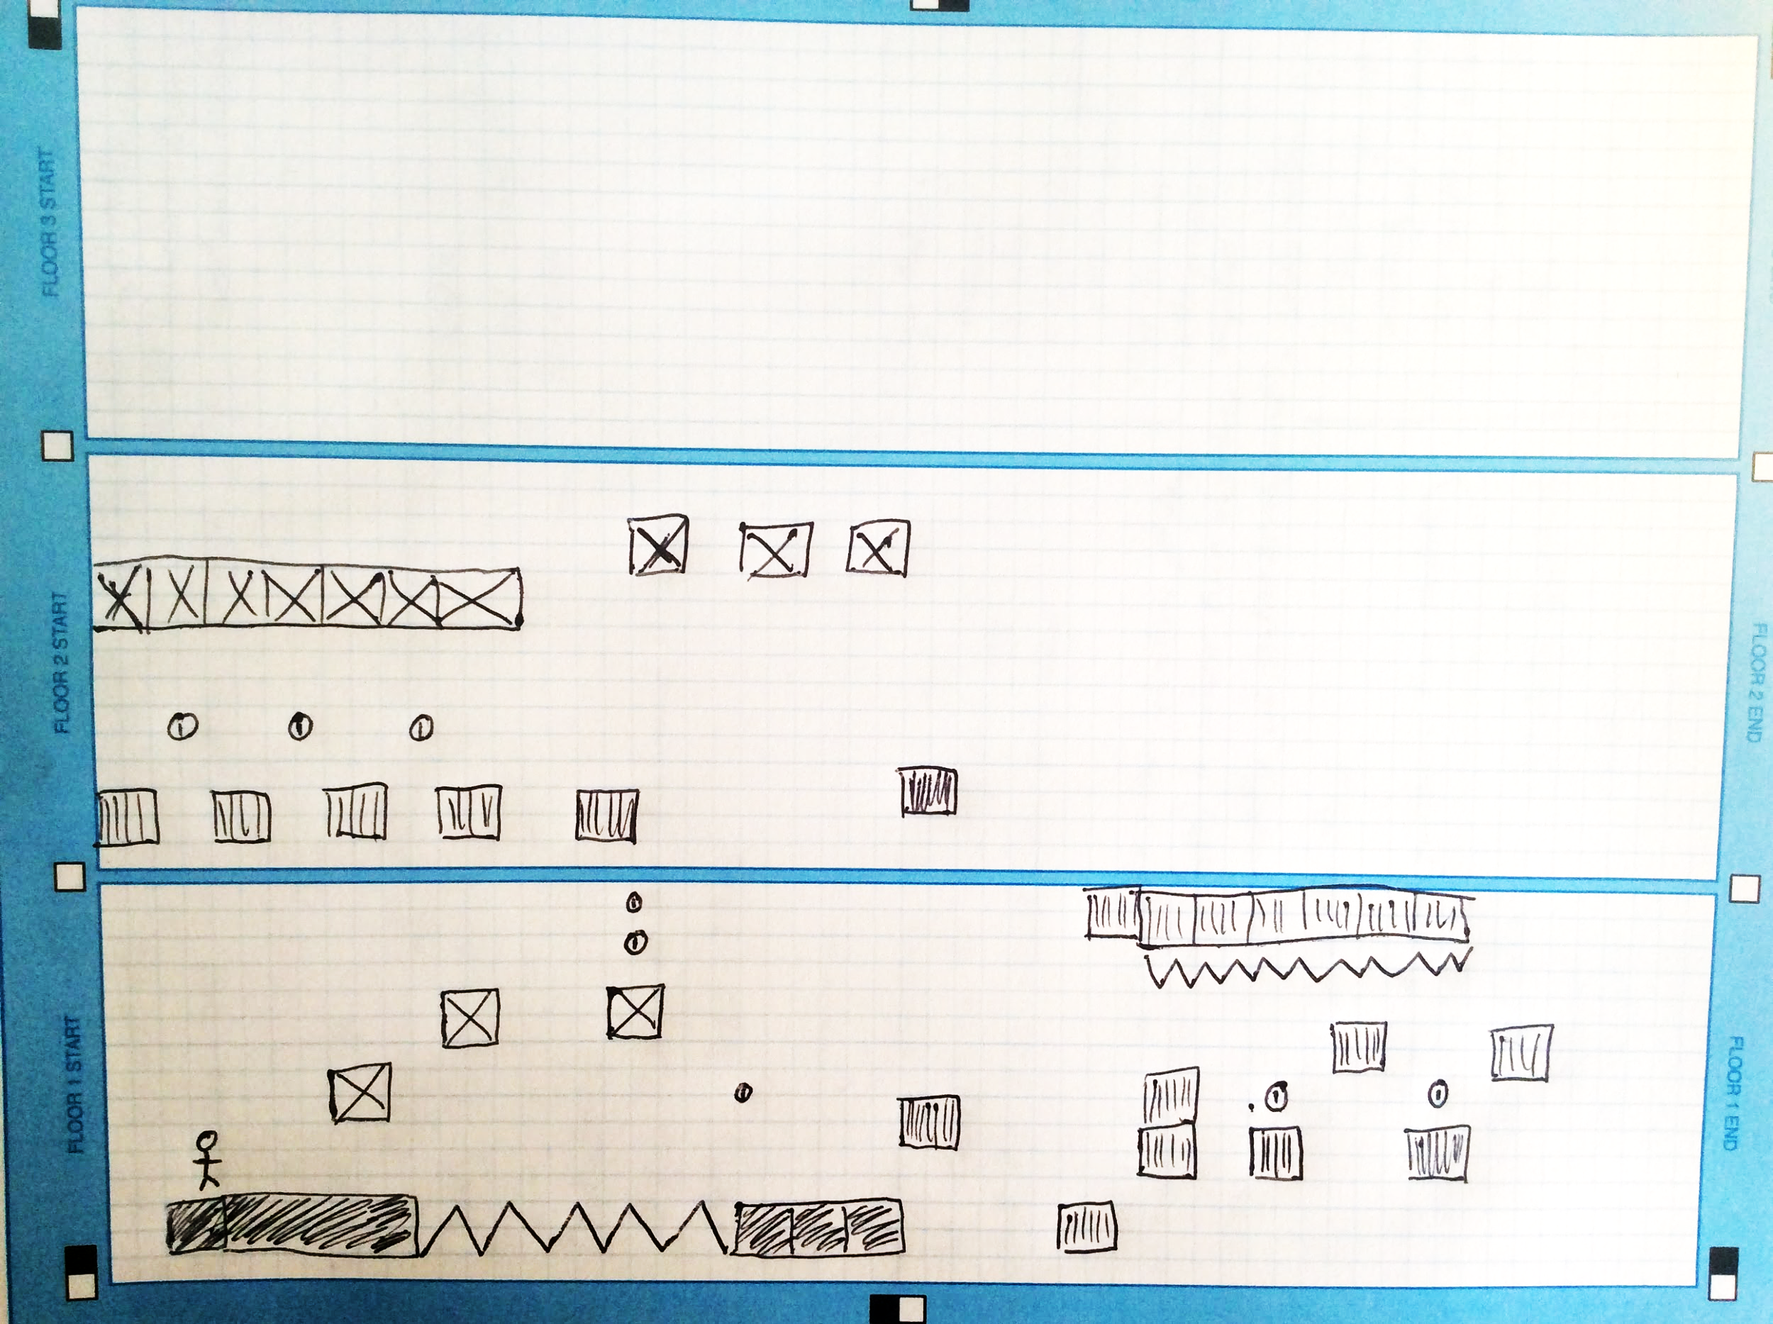
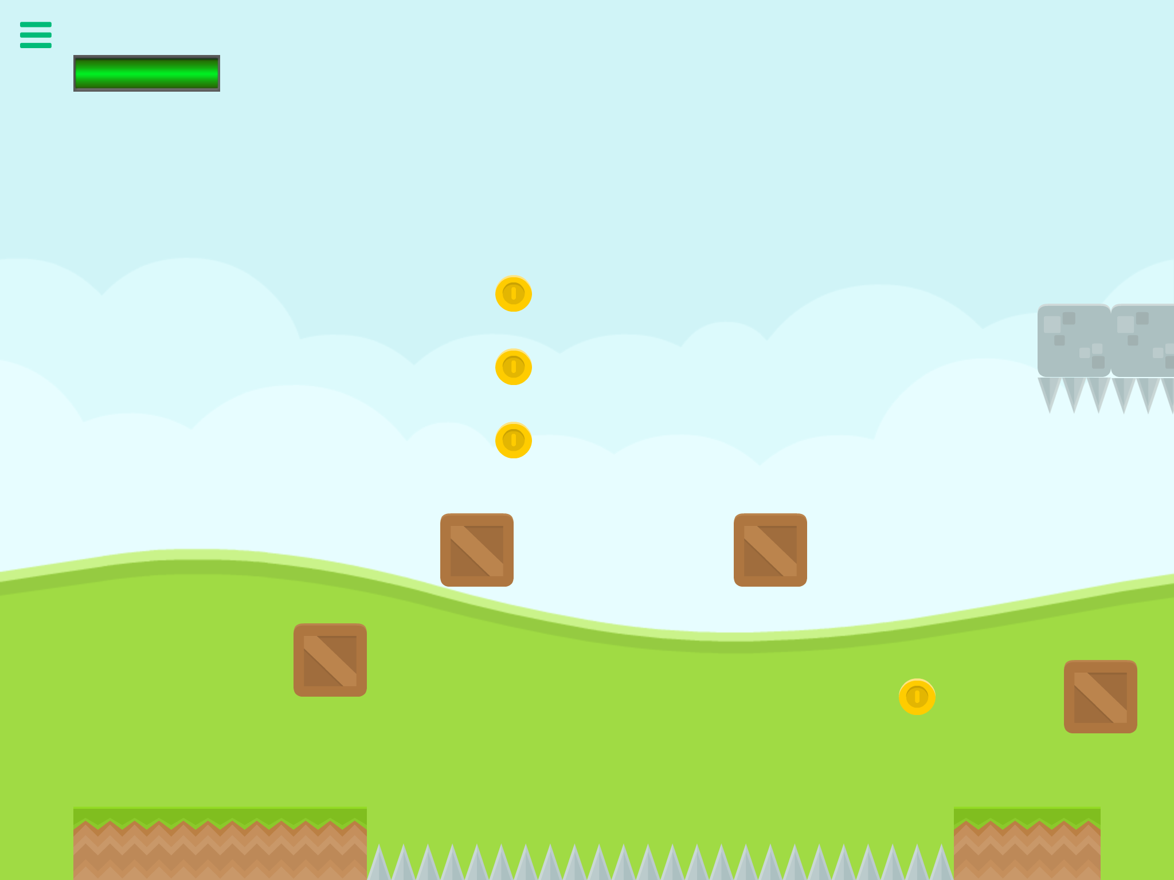
Example: Paper sketch to Hyperpad

Slide 16
Design your game!
Transfer your drawing
Make a New Project in Hyperpad
Select Side-View
Make your drawing of level-design come to life by placing your blocks and obstacles on the Hyperpad game surface

Slide 17
Create a New Project

Slide 18
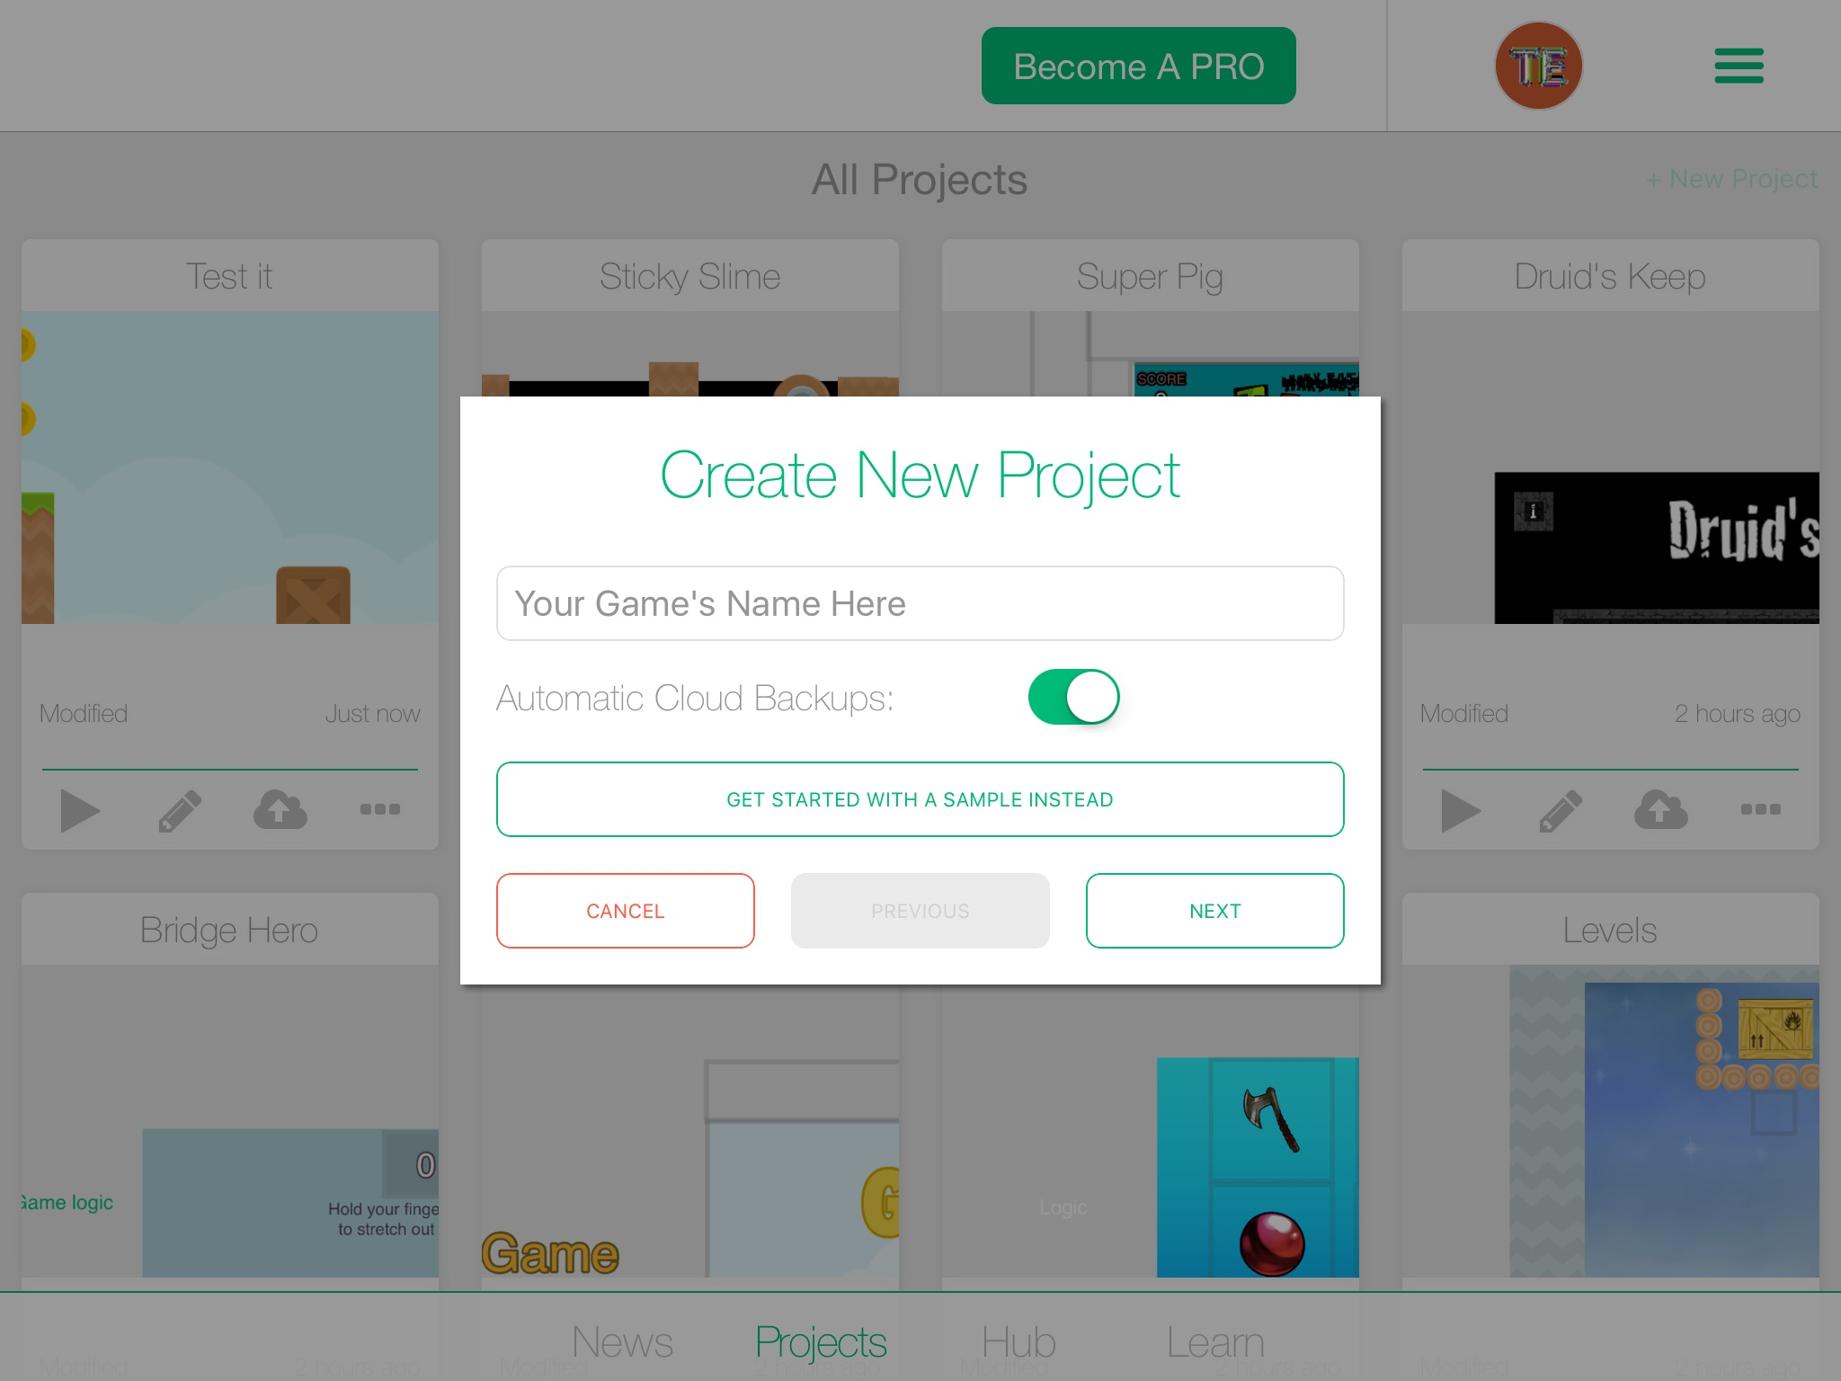
Tap +New Project

Slide 19
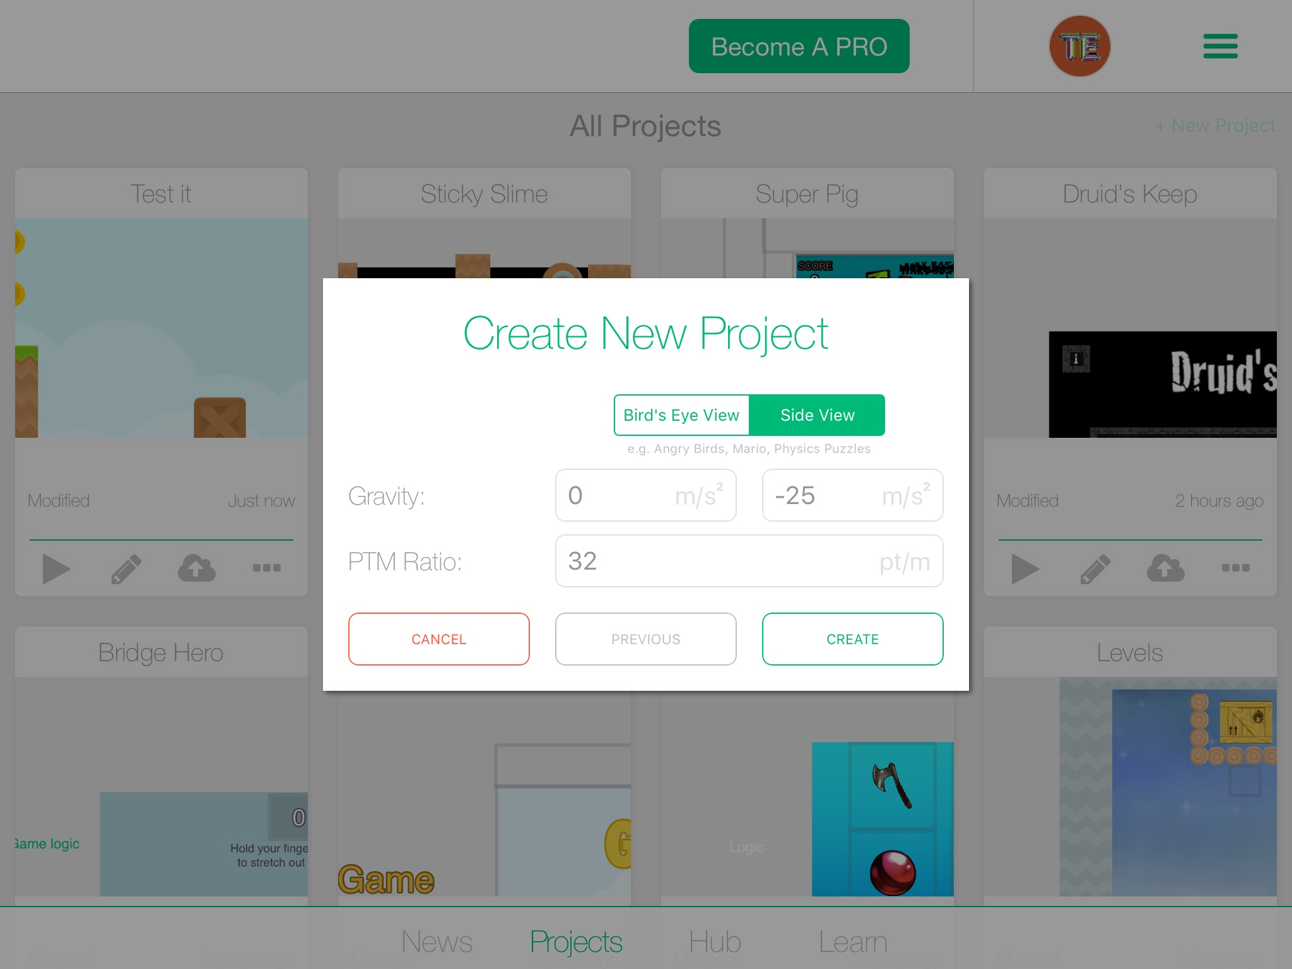
Make sure Side View is selected then hit create
Then tap “create new project”
1.
2.

Slide 20
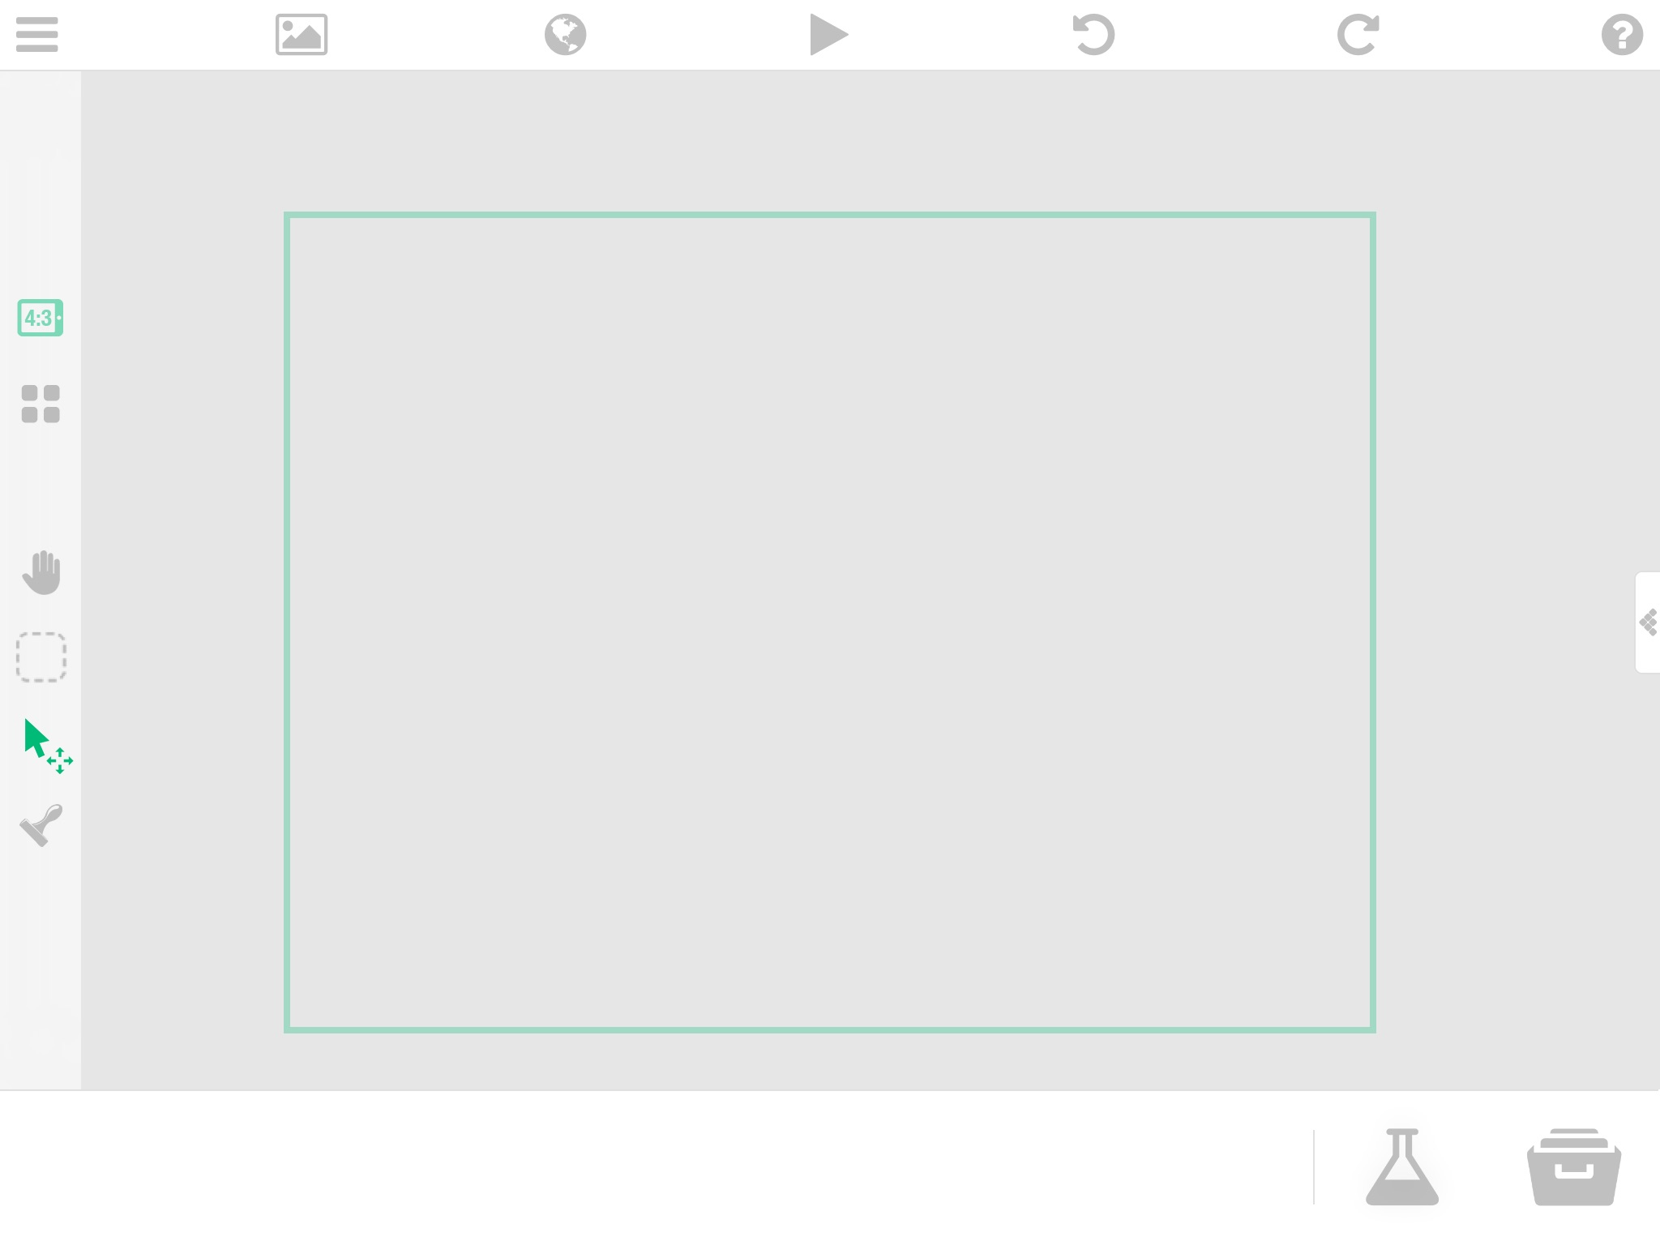
This is your game’s “surface”
The folder where you get all of your objects to place on the surface
Select this

Slide 21
How to get more objects

Slide 22
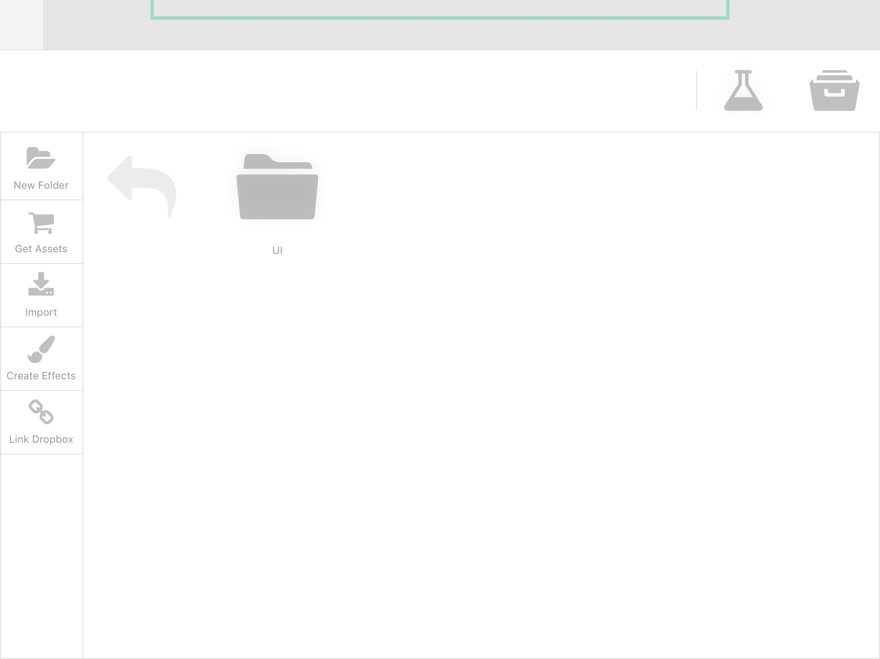
Right now, you just have one folder.
Get more objects by tapping “Get Assets”

Slide 23
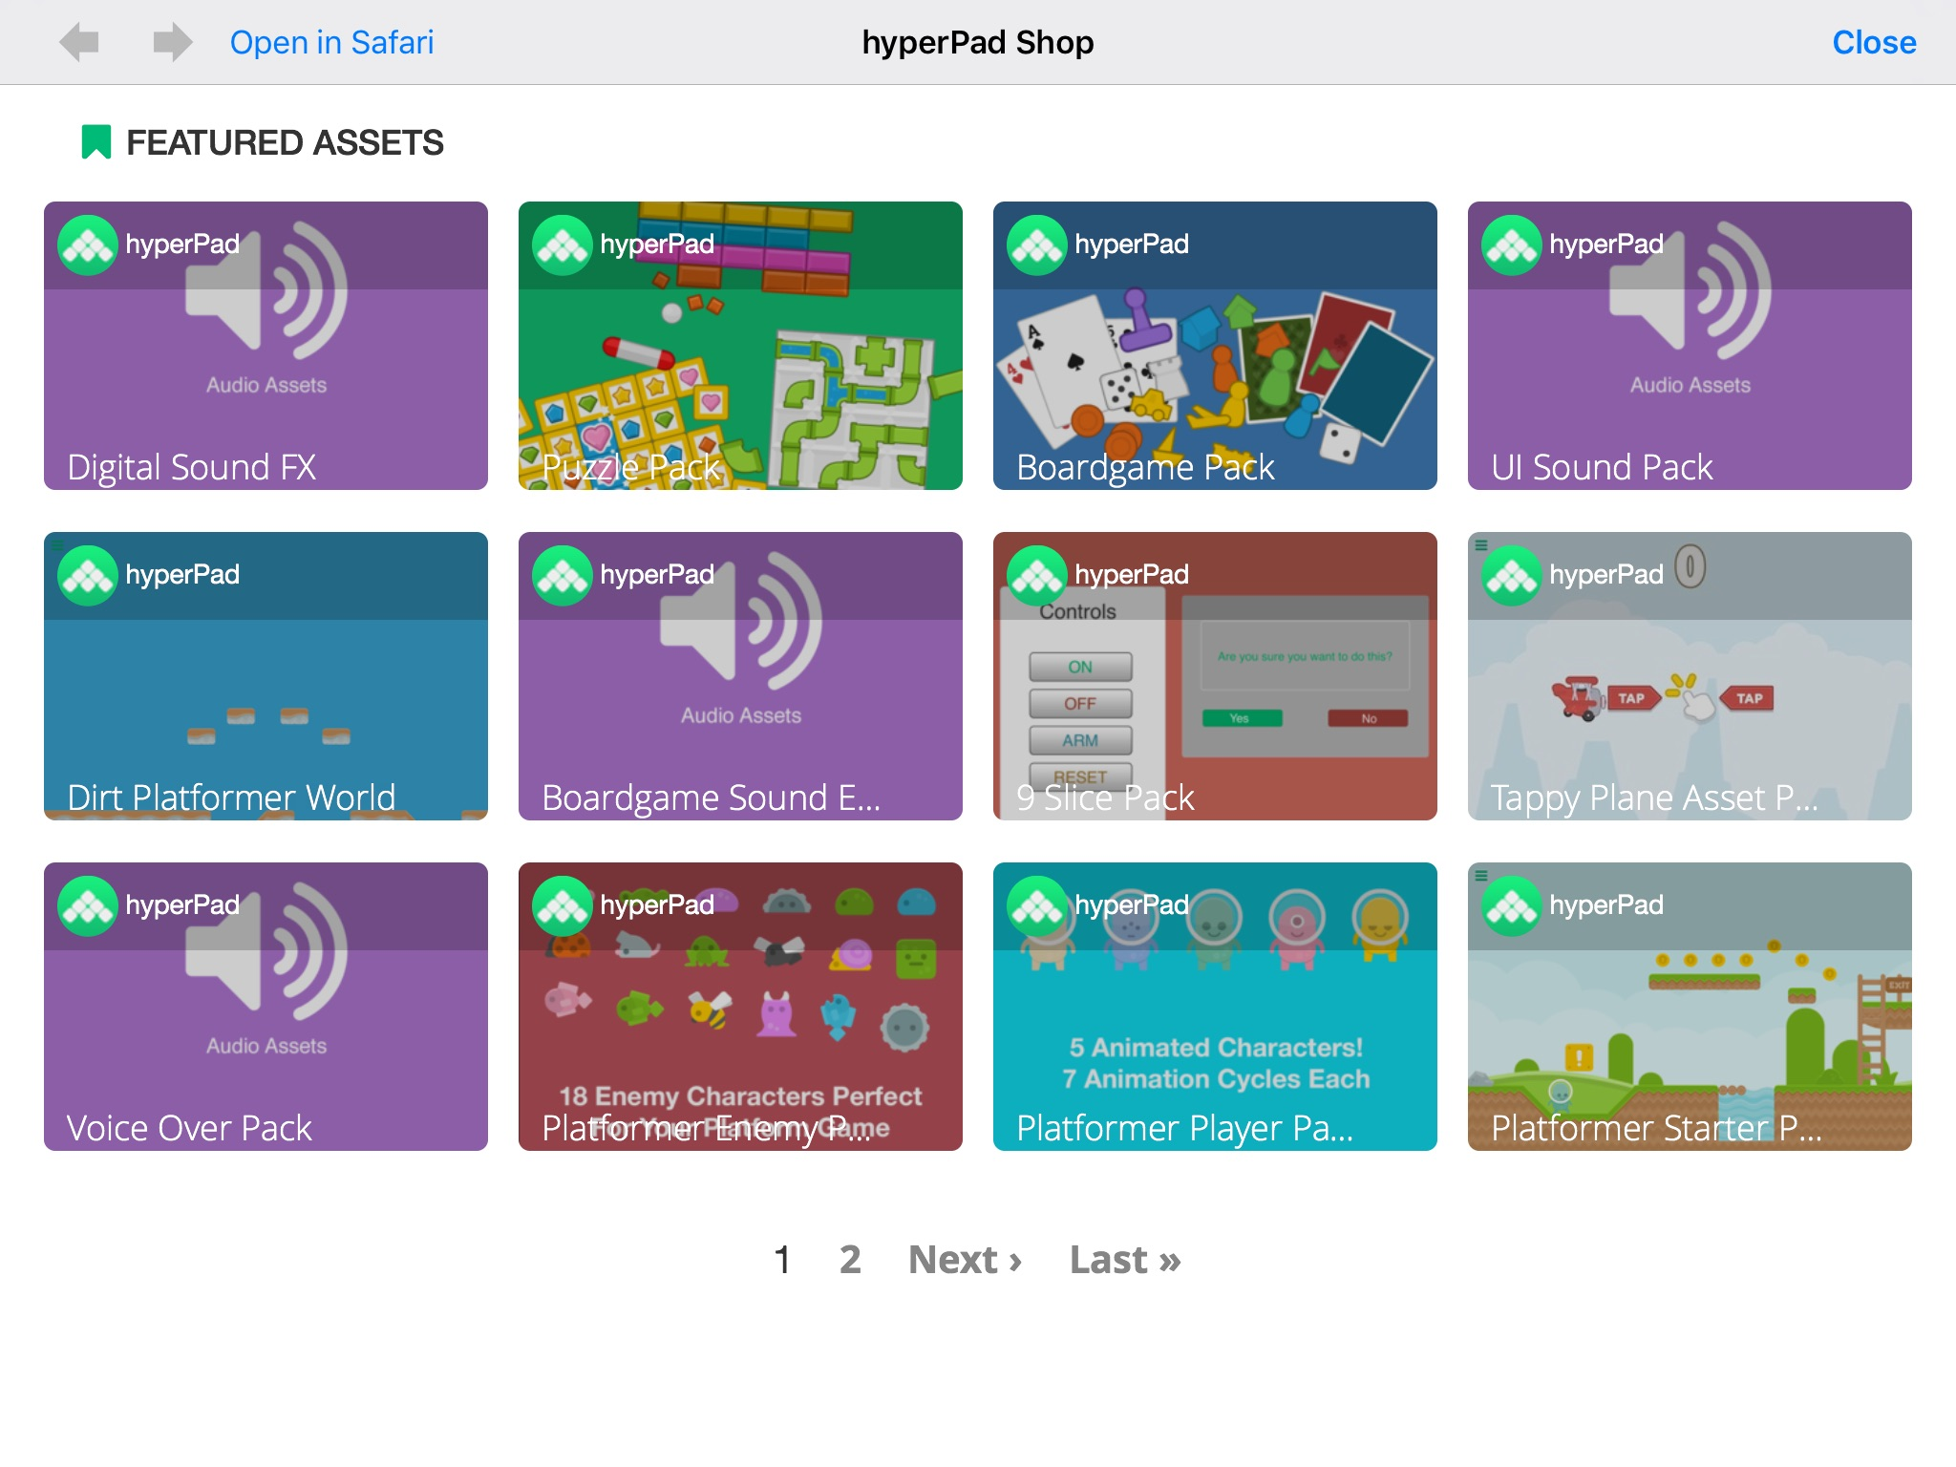
Start off by selecting the “Platformer Starter Kit” --then tap “Get”
You can always come back here and get more stuff

Slide 24
Choosing a Background

Slide 25
After Downloaded “Platformer Starter Kit”...
Tap the Background icon

Slide 26
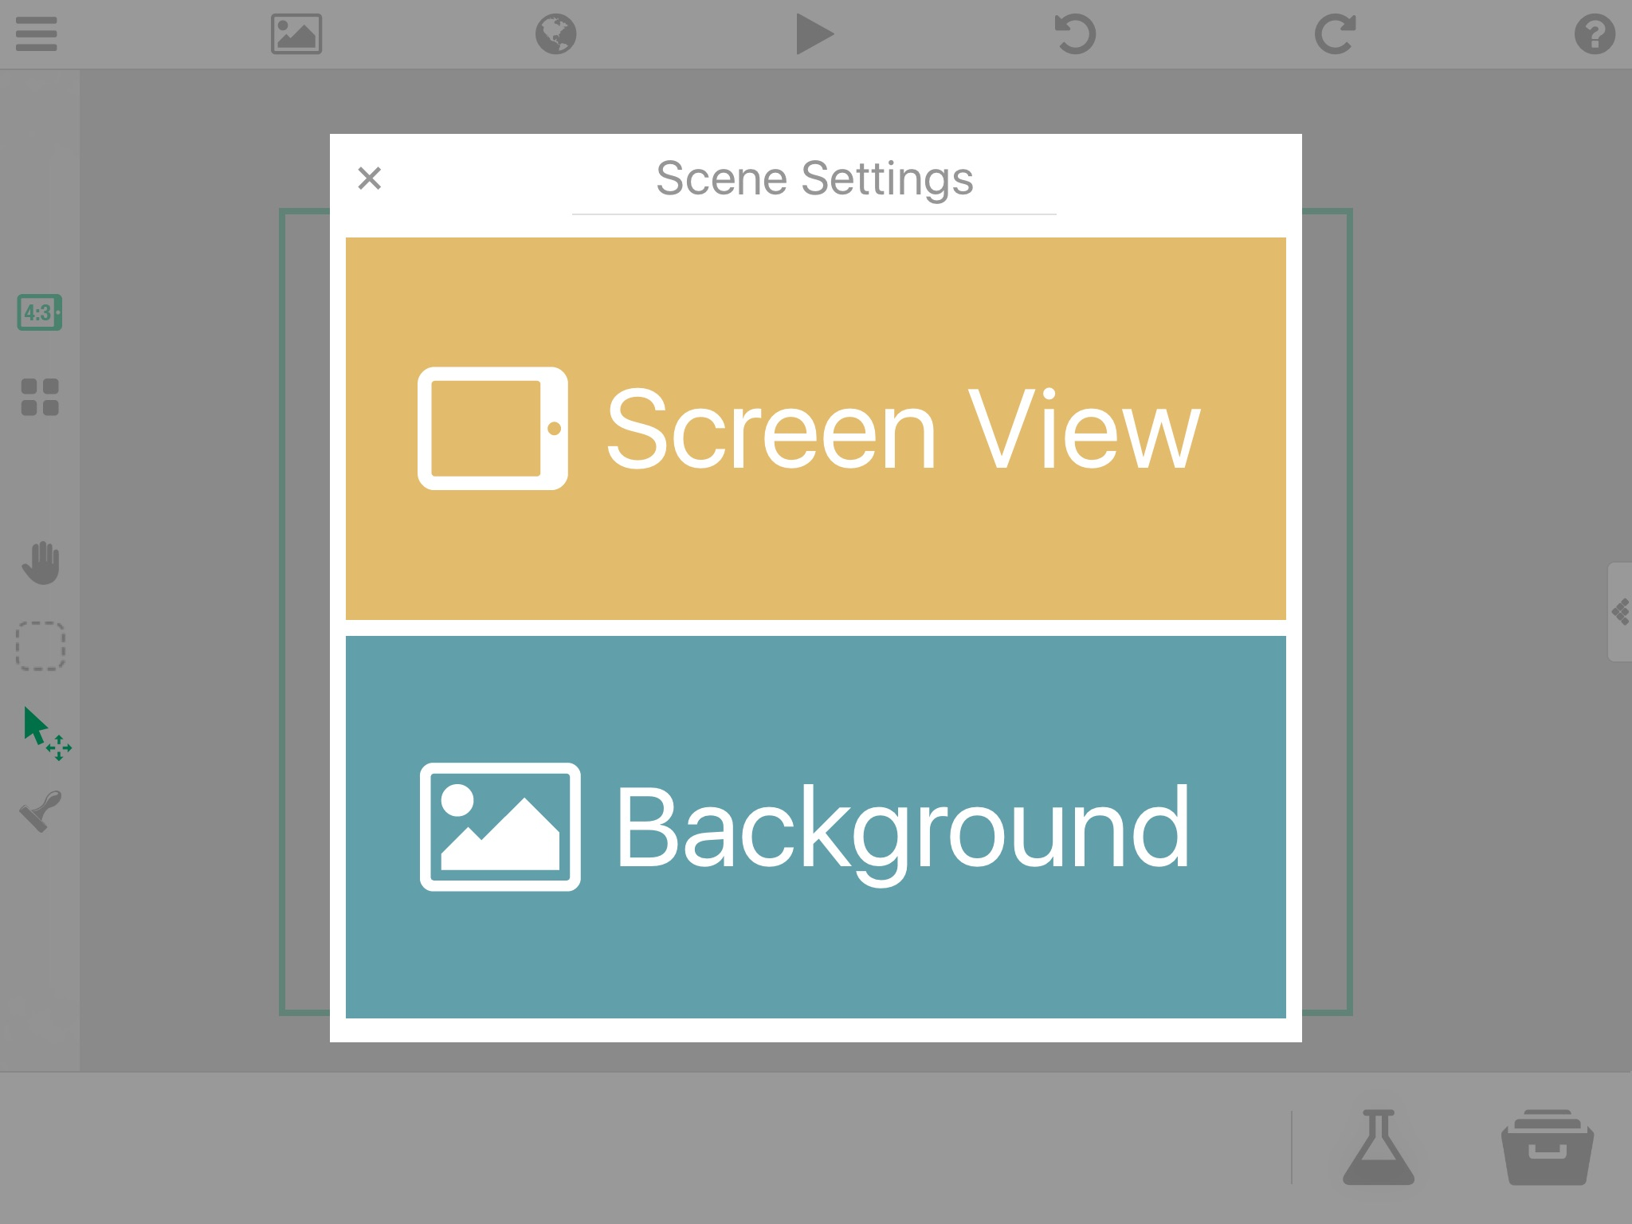

Slide 27
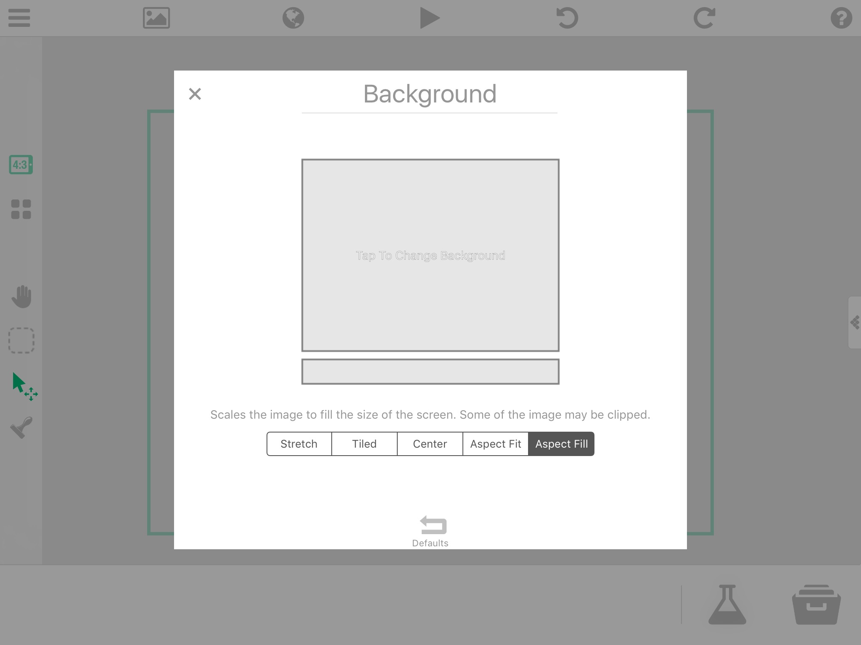

Slide 28
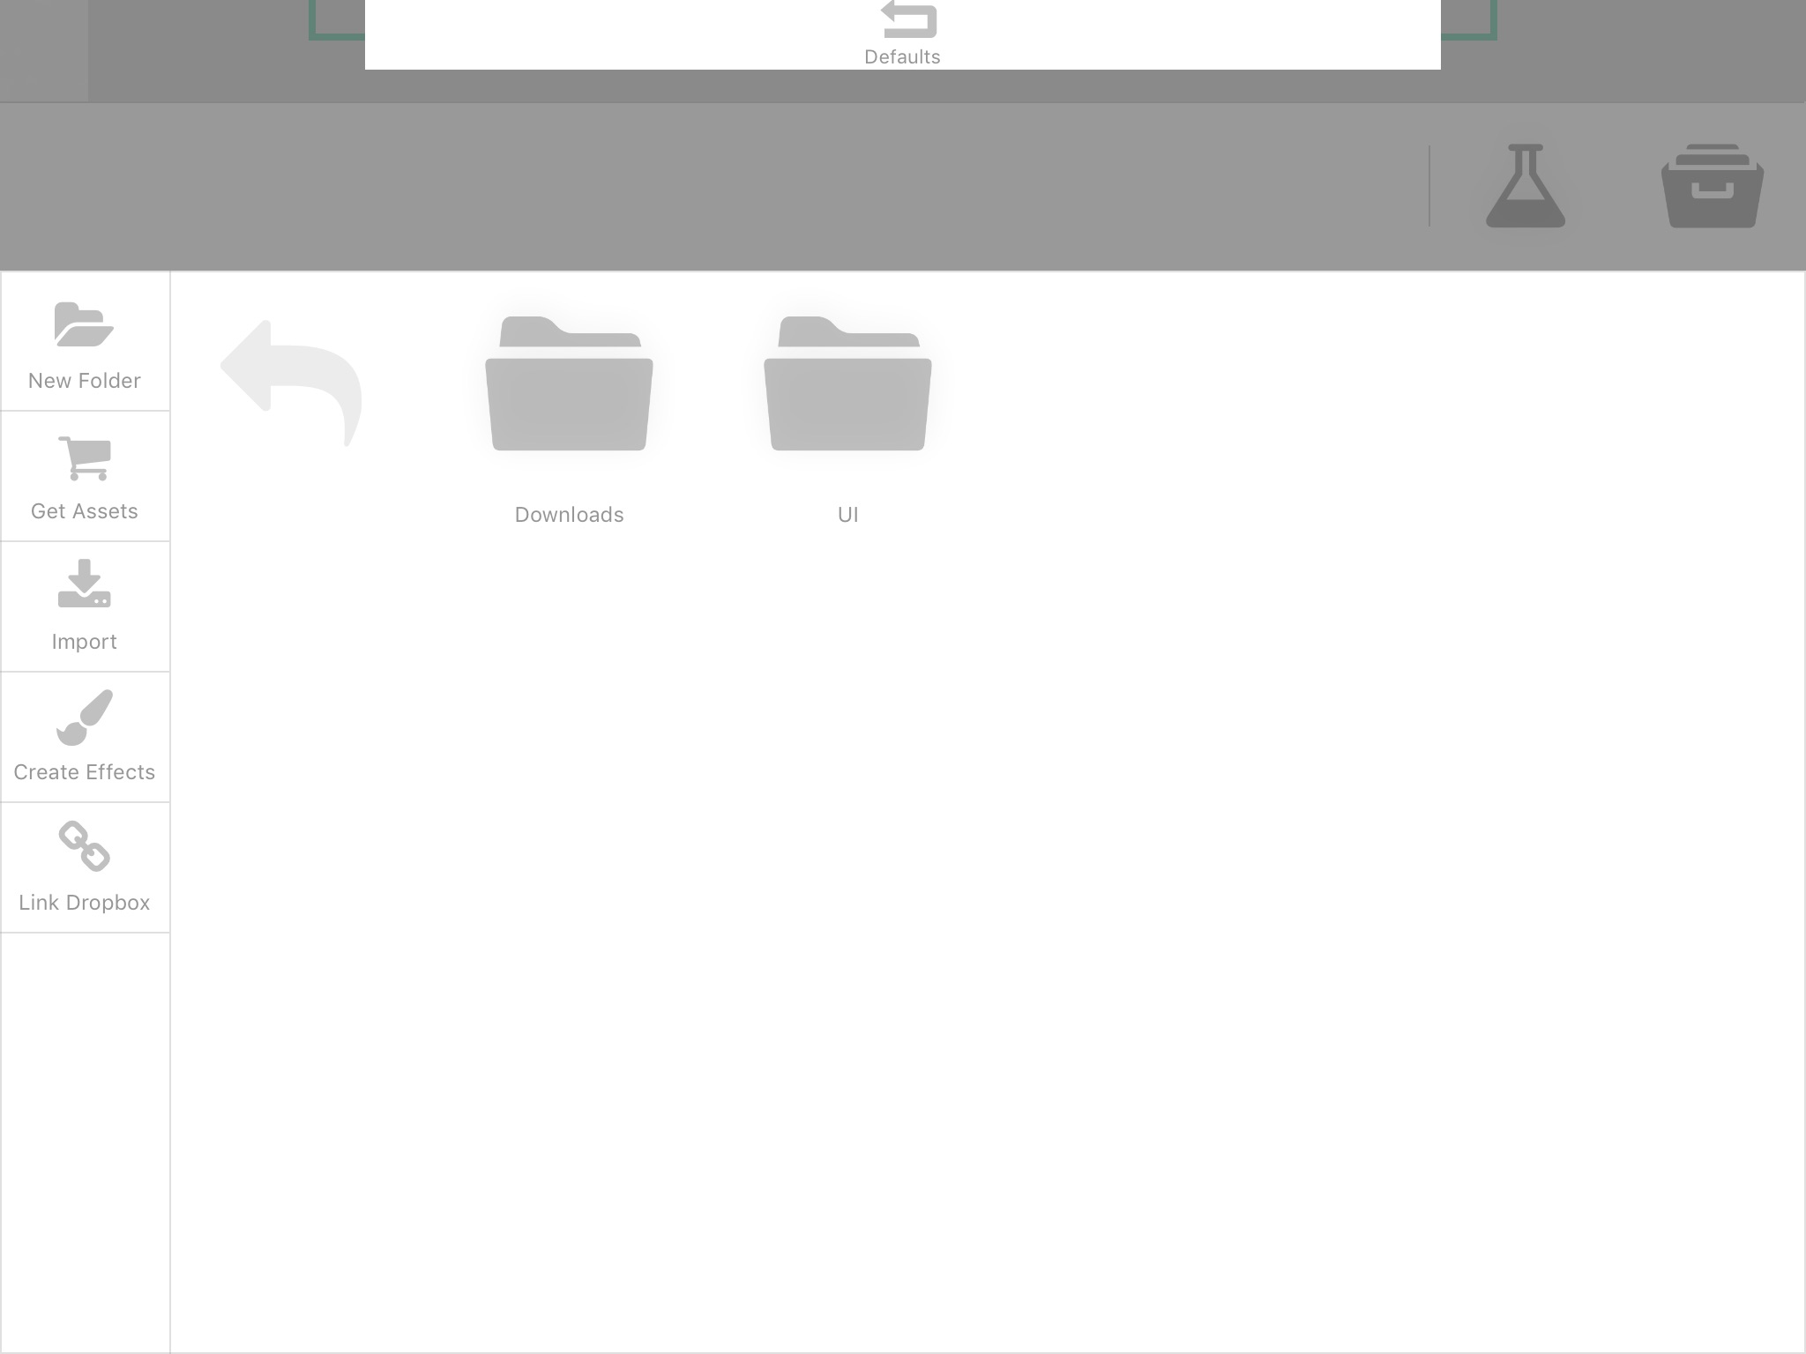
Select, Downloads and choose what background you want under the “Backgrounds” folder

Slide 29
Level-Design
Placing objects on your game’s surface

Slide 30
Level-Design
Design your level by dragging and dropping object blocks (Grass Blocks, etc.) on the surface of your game
You can start putting coins and obstacles
Think about creating secret paths or traps

Slide 31
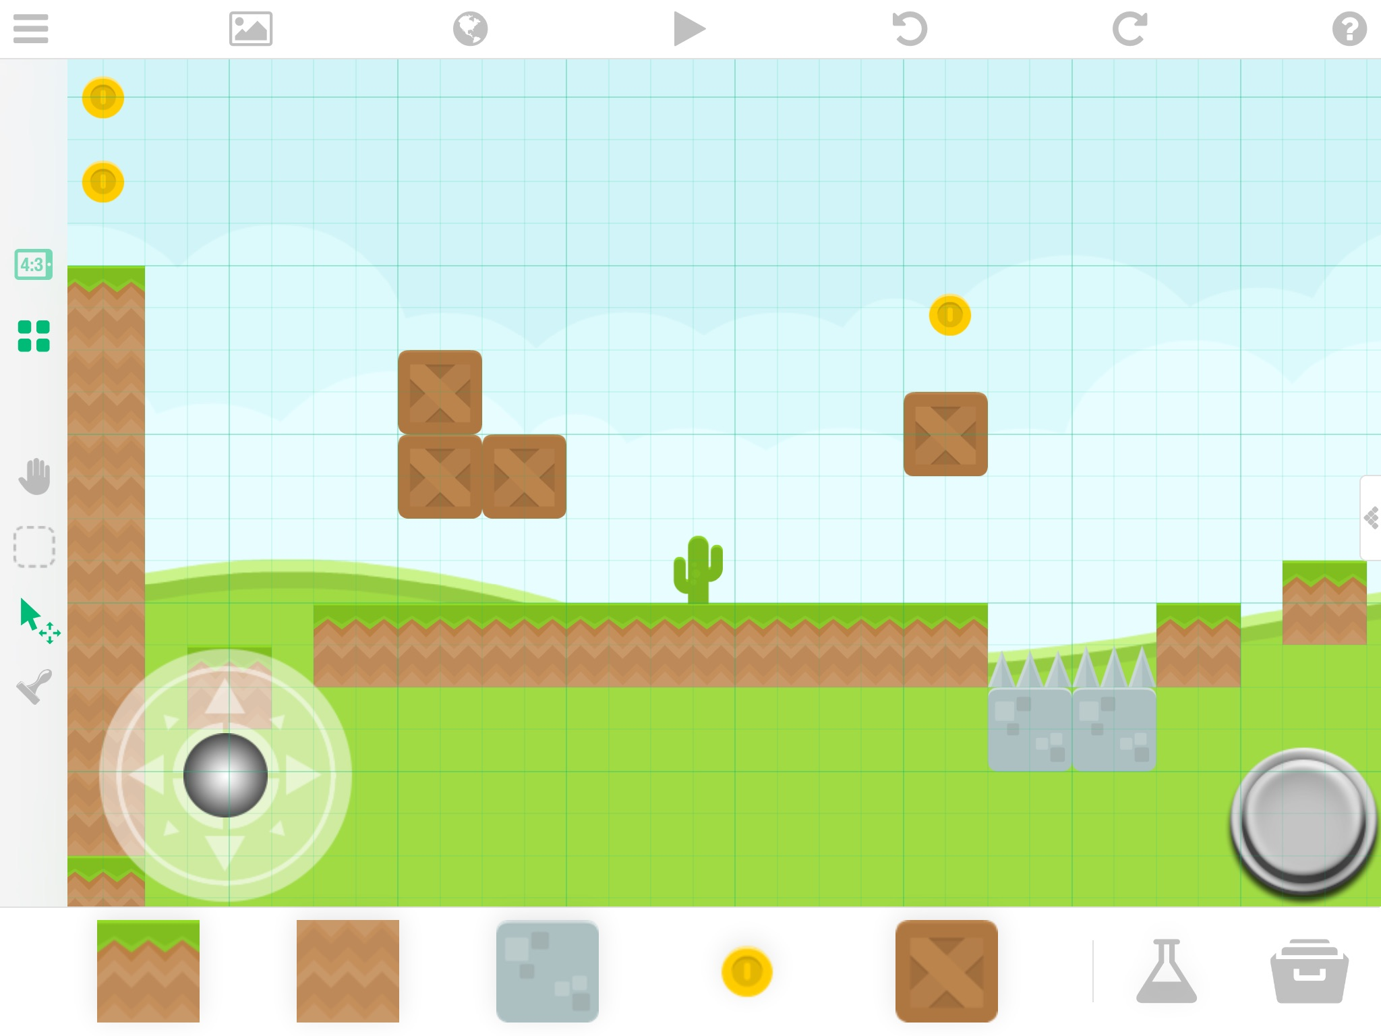
*Hint*
When dragging & dropping blocks/objects, keep this grid tool selected
This helps to keep everything aligned and snap together nicely

Slide 32
Making Your Character Move
Changing the Behaviours

Slide 33
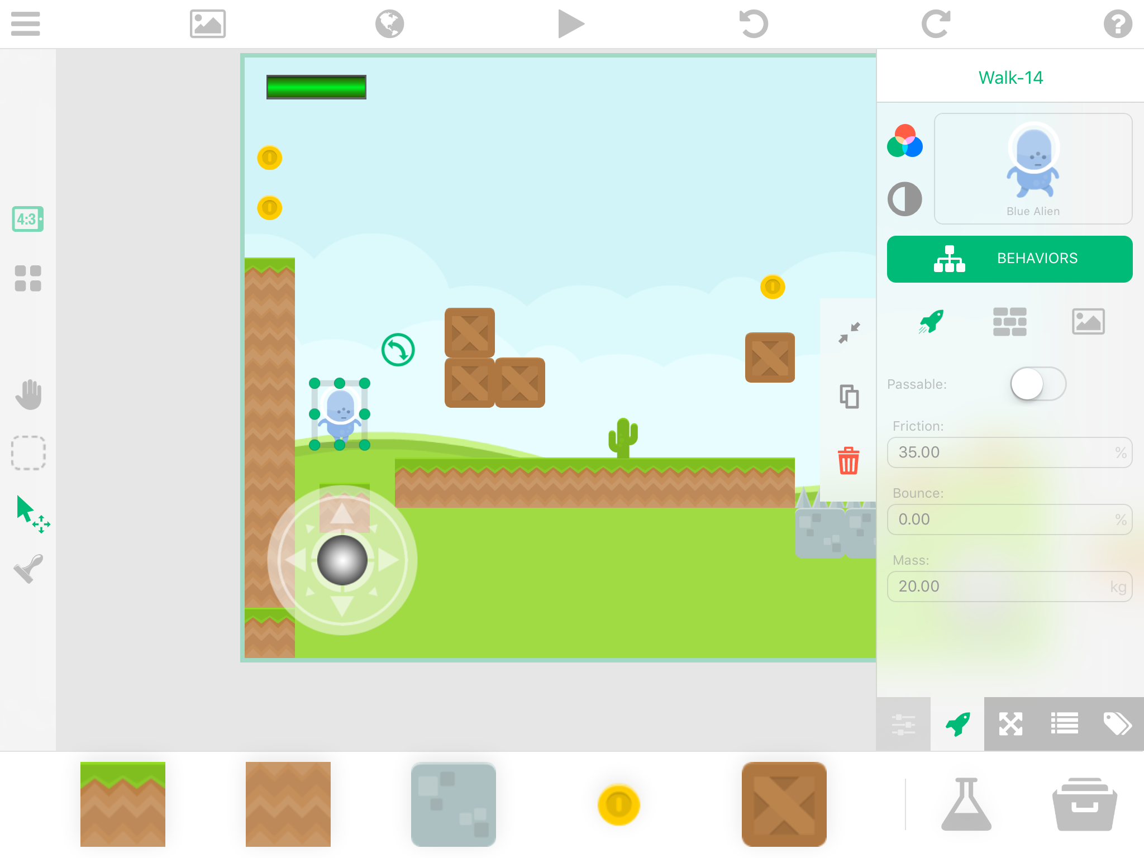
FIRST, make your character a “physics” object
Then, tap “behaviors”

Slide 34
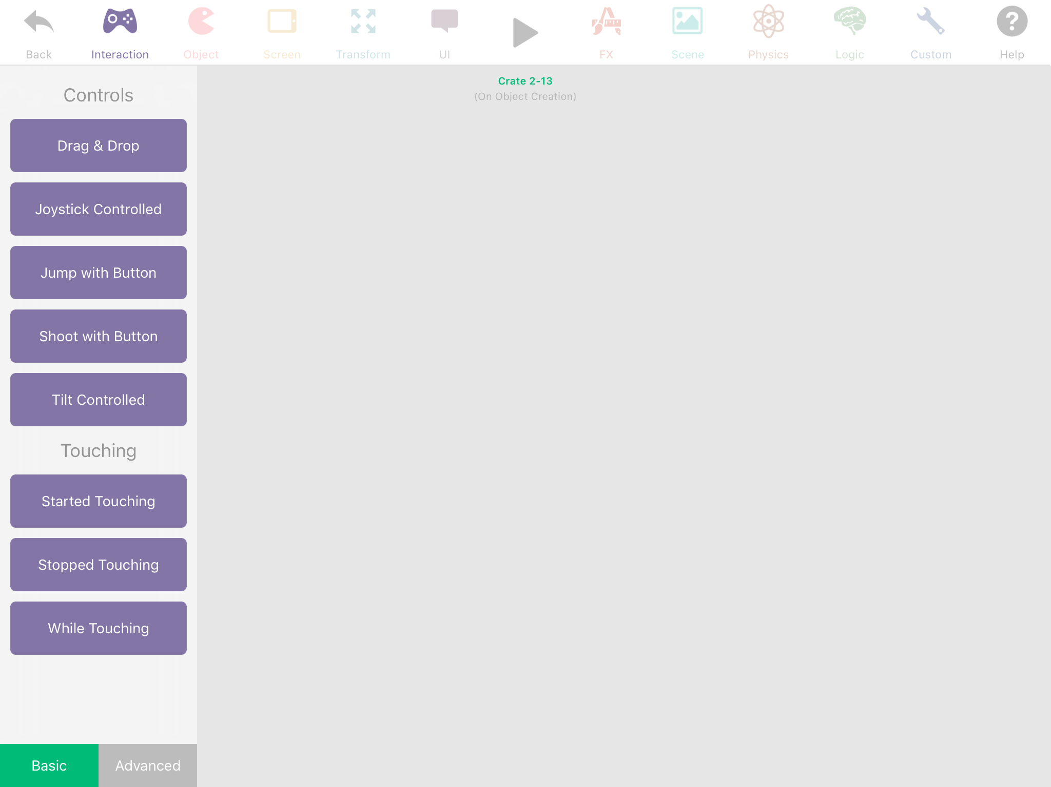
Categories of all of the different behaviours YOU can manipulate

Slide 35
Once you ready to test the behaviours you changed, select the PLAY button

Slide 36
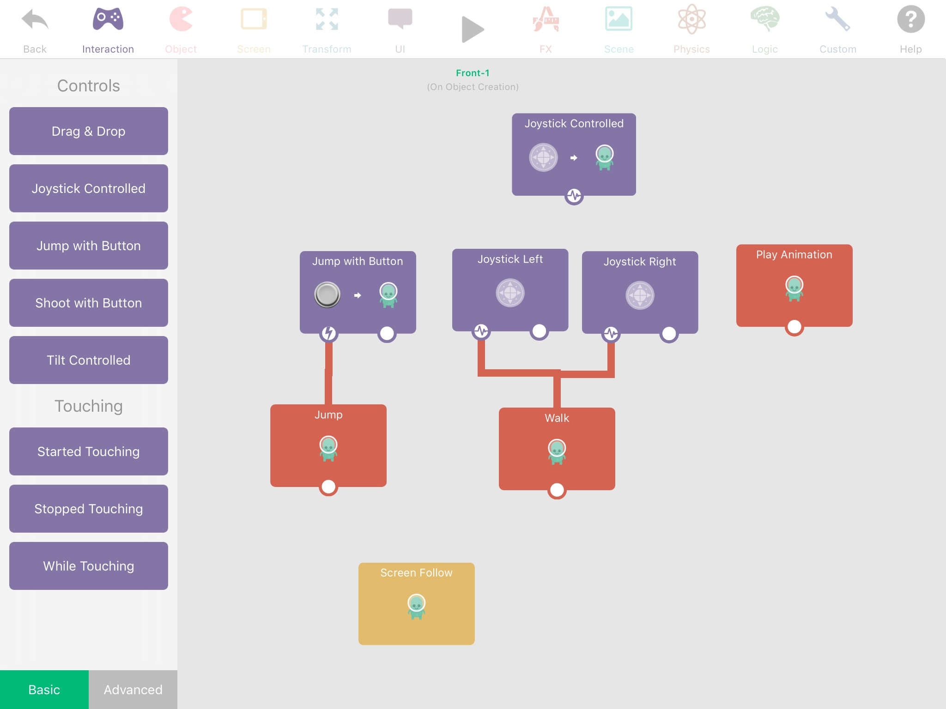

Slide 37
To have your character walk and jump smoothly, attach animation behaviours from the “FX” category
These are also known as “sprites”

Slide 38
Obstacle Behavior
Changing the Behaviours to make objects behave like obstacles

Slide 39
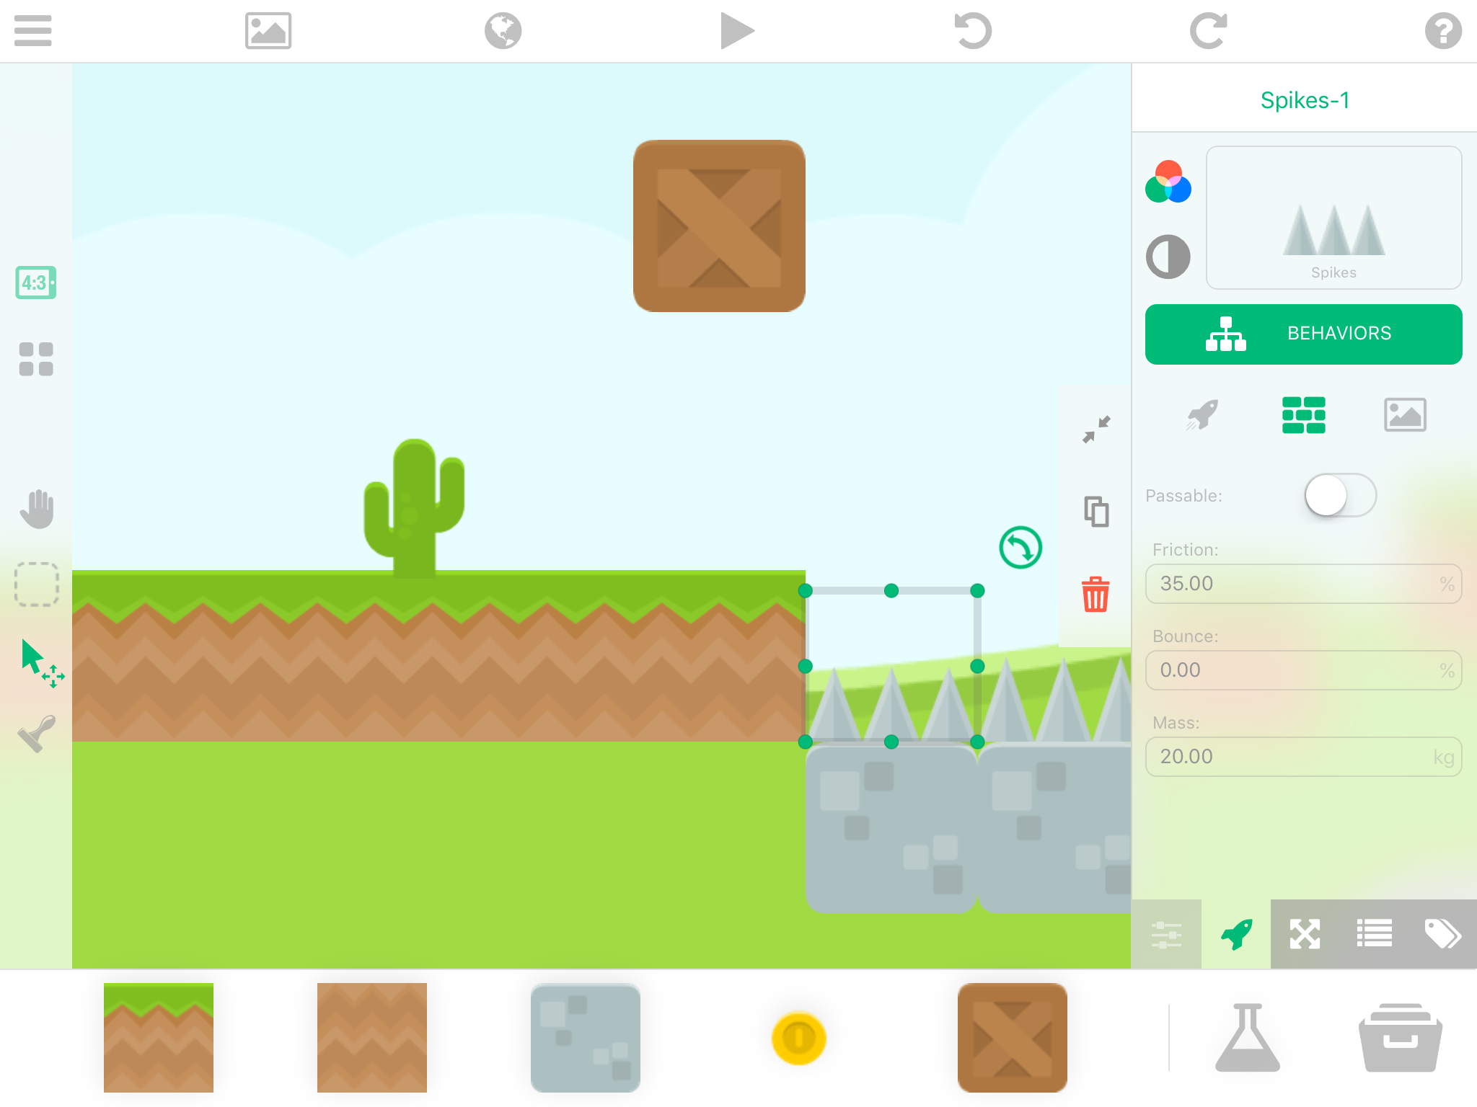
Let’s make your obstacles “bad news” for your character

Slide 40
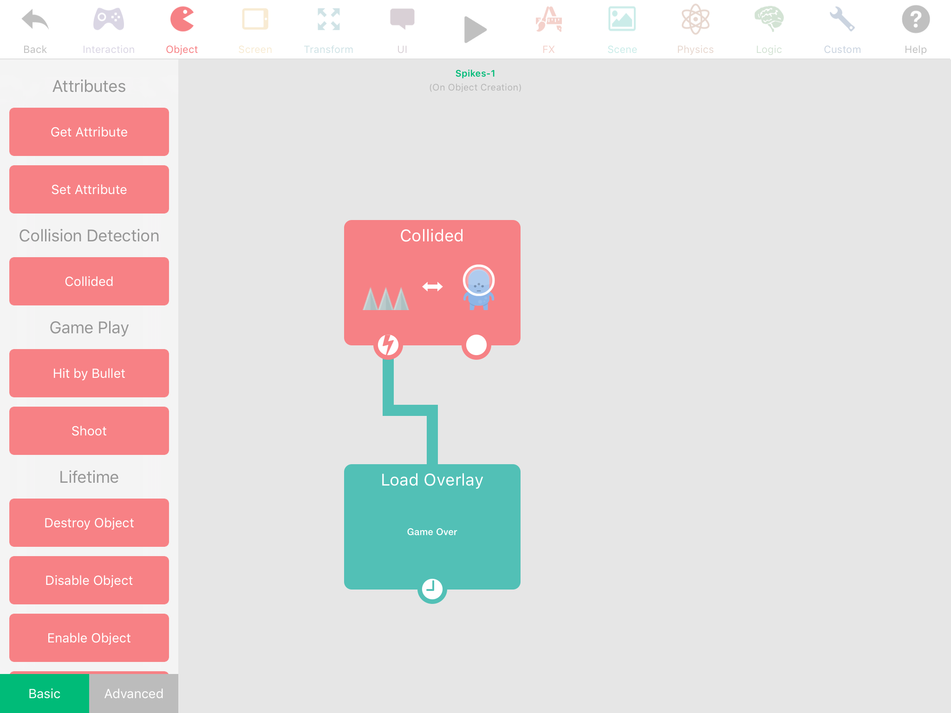
CONDITIONS:
Once the spikes collide with the spaceguy…
Then, Game Over!

Slide 41
Collectable Behaviors
Changing the Behaviours of objects so the main character ‘collects’ them

Slide 42
Collectables Behaviours
Setting up the behaviours for collectibles, like coins, gems, keys etc. is similar to obstacle behaviour
First, there is a collided behaviour
Second, something happens after that
For example,
When a character collides with a coin, the coin disappears
You can even add that to your character’s score

Slide 43

Reinvent the Wheel!!!
When you run into a problem, think about if you have seen a similar problem before
What did you do then?

Slide 44
Enemy Behaviors
Changing the Behaviours of more objects

Slide 45
Enemy Behaviours
Again, setting up the behaviours for enemies is similar to those for coins and obstacles
The main differences:
You can have the enemy move (“patrol”)
Once you collide with the enemy, your health bar can go down or it can be game over

Slide 46
Health Bar
Creating a working health bar for main character

Slide 47
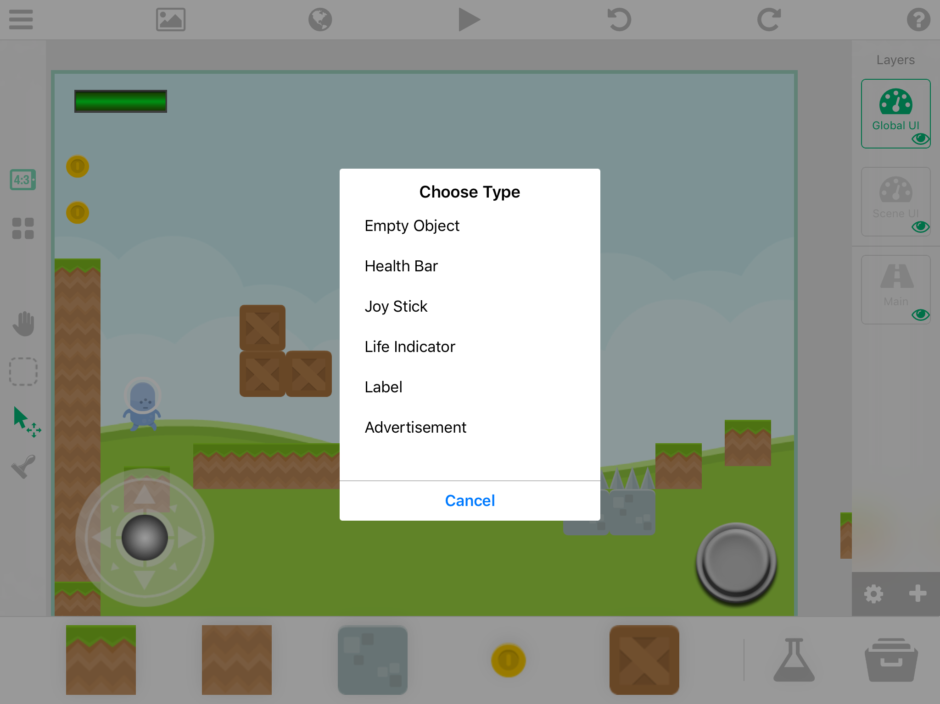
Make sure you are in the “Global UI” layer
Select the “erlenmyer flask” at the bottom of the screen
Select the “Health Bar”
Make sure you switch back to the “Main Layer” when you want to place more objects

Slide 48
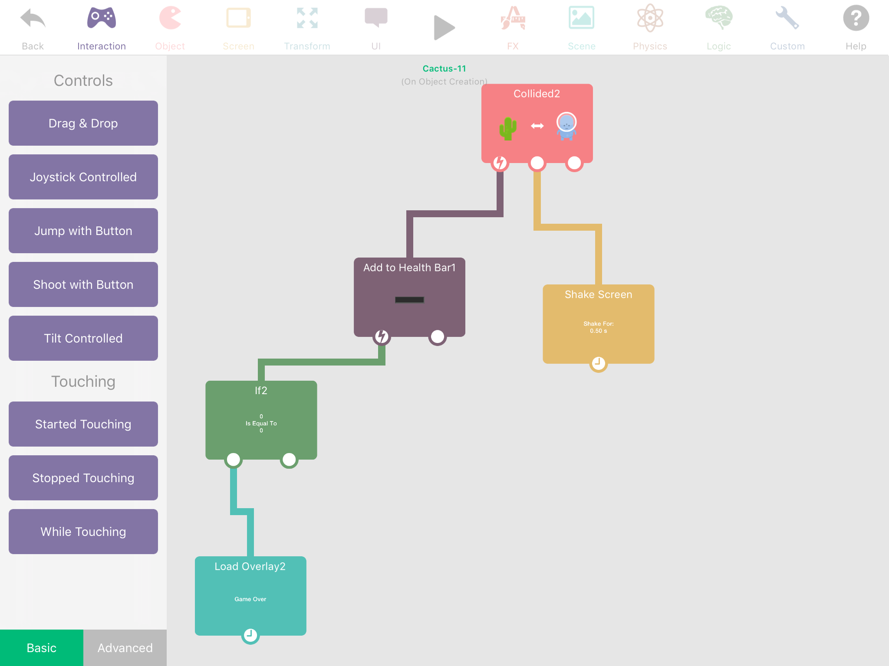
Here’s how you would set up obstacles to hurt your character’s health

Slide 49
Adding Points
Get points for collecting coins (and other collectibles)

Slide 50
Make sure you are in the “Global UI” layer
Select the “erlenmyer flask” at the bottom of the screen
Select the “Label”
Make sure you switch back to the “Main Layer” when you want to place more objects

Slide 51
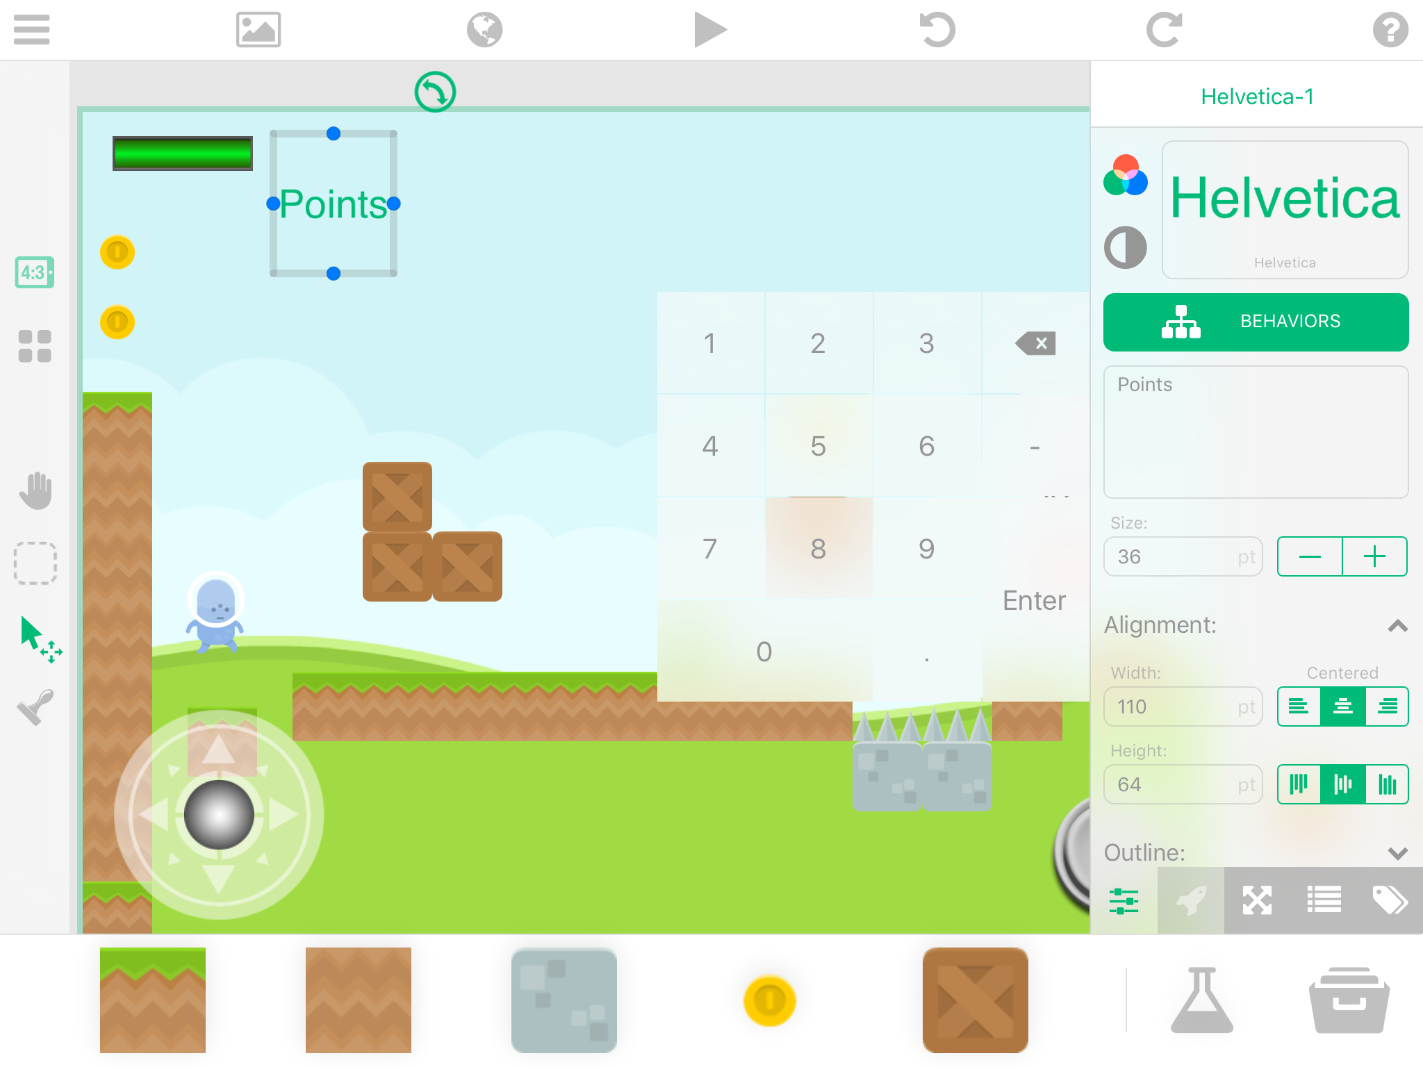
Change the label to say Points (or coins, etc.)
Change the Alignment
Make sure you switch back to the “Main Layer” when you want to place more objects

Slide 52
Then, Repeat
Make One more Label
This is the label that will change each time you collect things

Slide 53
Make sure you are in the “Global UI” layer
Select the “erlenmyer flask” at the bottom of the screen
Select the “Label” again
Make sure you switch back to the “Main Layer” when you want to place more objects

Slide 54
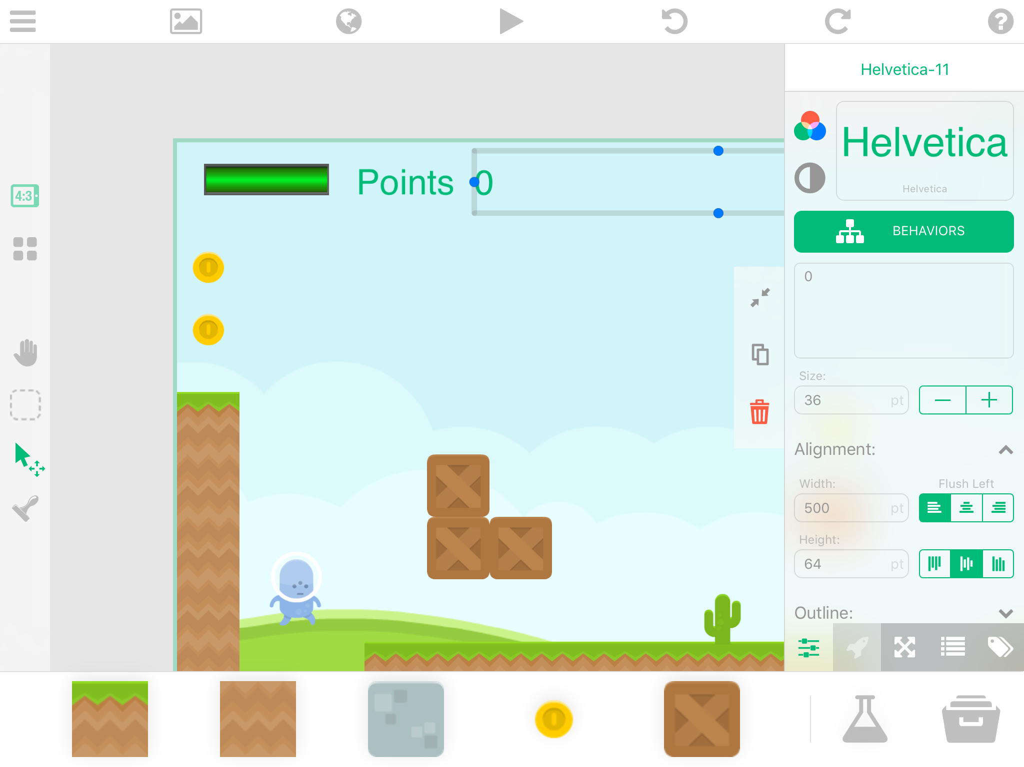
Name this label the number: zero
Line it up next the previous label: “Points”

Slide 55
Making the Points Label Add
Get points for collecting coins (and other collectibles)

Slide 56
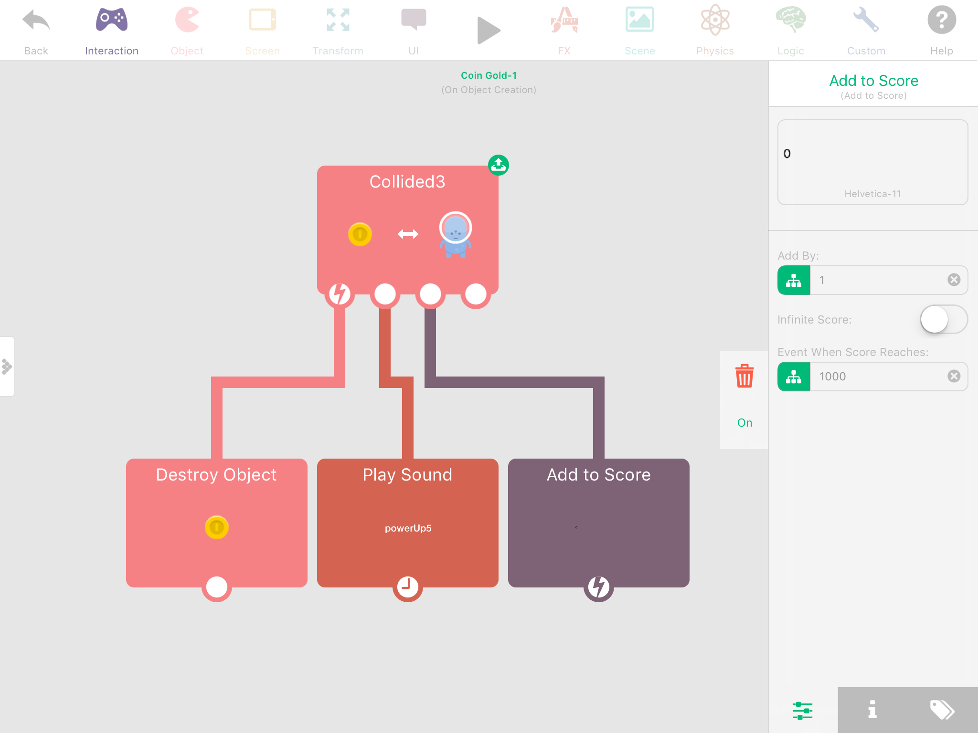
Choose the label to add to

Slide 57
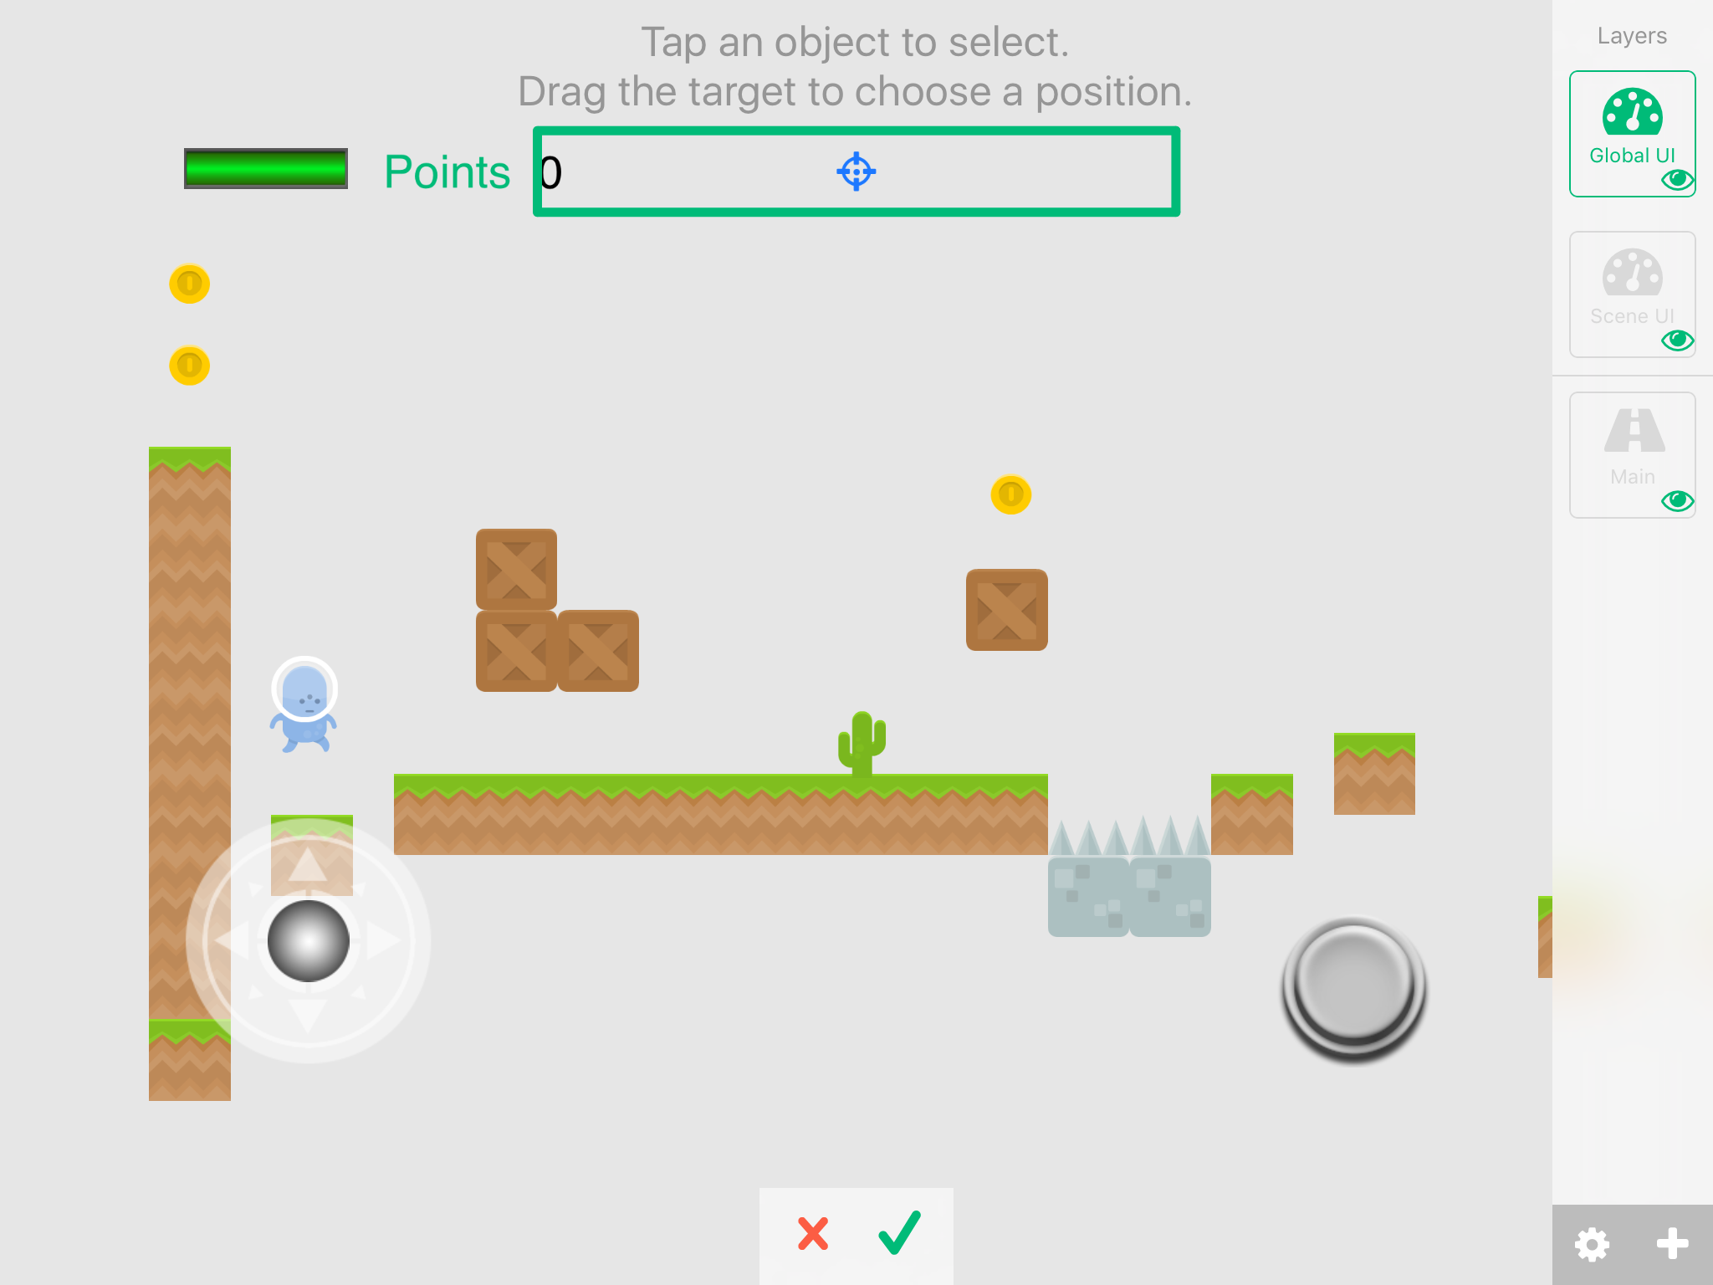
For the coin’s behaviours, be sure to select the label that is names “0”
Also, be sure to be under the “Global UI” layer

Slide 58
Now Test it out!
You will now see your points add up when you collide with coins

Slide 59



Design Thinking Interview
Day 4

